Slide 1
Portfolio Screenshots Mandeep Shergill
March 28, 2024

Slide 2

Home Page

Slide 3
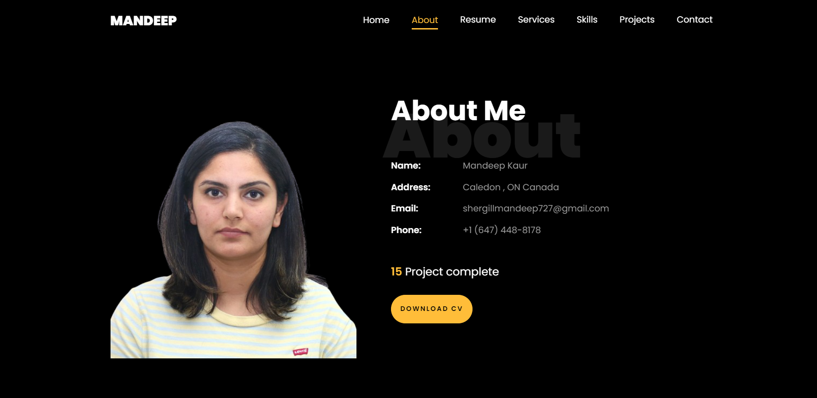
About

Slide 4

Resume Page

Slide 5
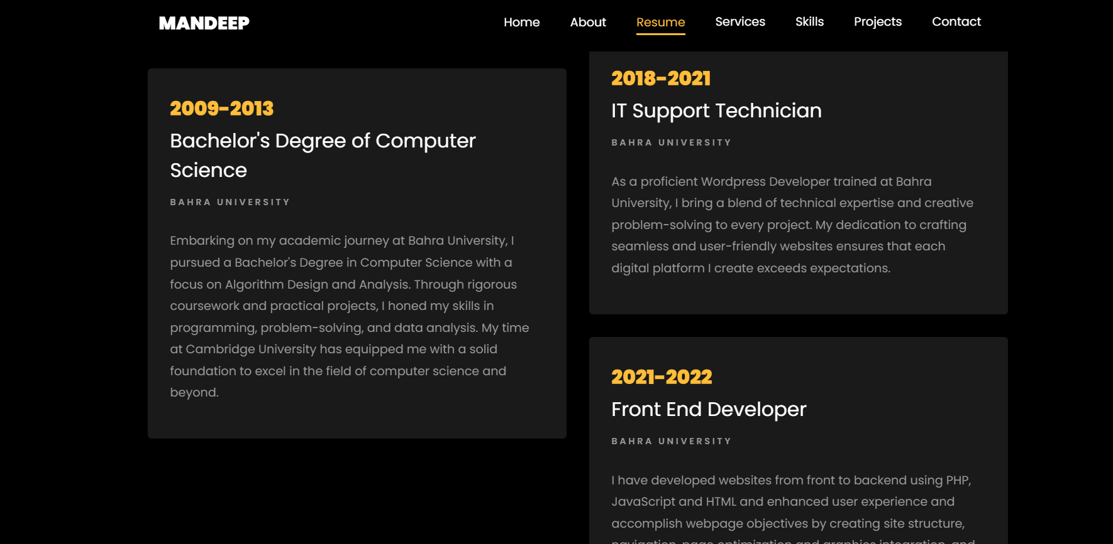
Resume Page

Slide 6

Services

Slide 7
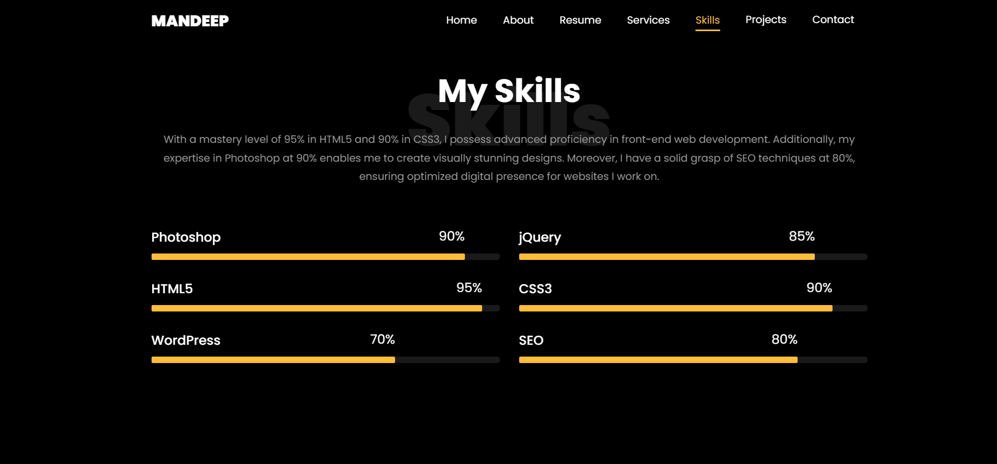
My Skills

Slide 8

My Projects

Slide 9


Slide 10
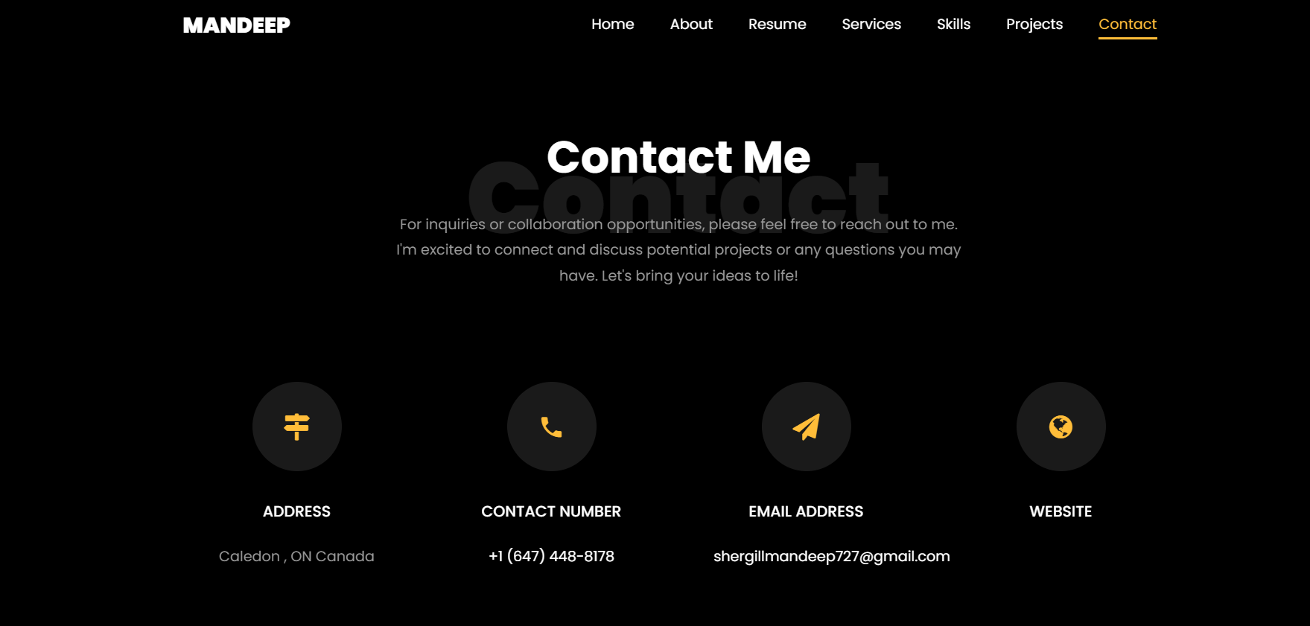
Contact Me

